Slide 1
Digital Client Onboarding (DCO) and Fraud IQ Manager
Backgrounder
March 2024

Slide 2
History
A real-time fraud check was incorporated into the original designs for Digital Client Onboarding (DCO), starting with Motive DCO in 2020
  The same service is used for CWB Personal DCO (self-serve) and when onboarding business owners/directors/signers via Small Business DCO (self-serve)
The fraud check service uses an Equifax product
  Citadel > Luminate > (now) Fraud IQ Manager (FIQM)
Ten real-time rules were configured when DCO was first implemented
  The rule scores have never been updated
  The decision thresholds (which determine if an application is sent for review or declined) have never been updated

Slide 3
Current state
Each of the 10 configured rules is automatically run for each DCO applicant against 3 datasets
  Local: fraudsters known to/identified by CWB*
    *Configured in CWB’s instance of Fraud IQ Manager
  National: fraudsters identified by members of the FI consortium
  Telco: fraudsters identified by members of the telco consortium
If the applicant triggers one or more of the real-time rules, they are assigned a score for that rule
If the total rule score is >25, the application is flagged for fraud review
  This results in the DCO application landing in a specific fraud queue for manual intervention
If the total rule score is >=100, the application is declined

Slide 4
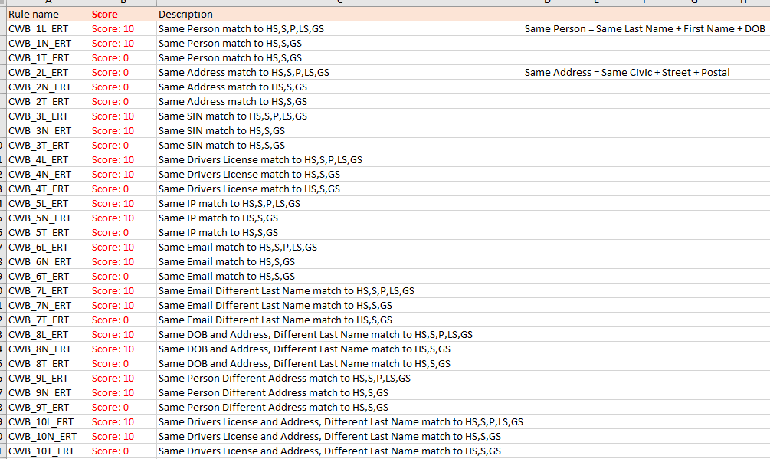
Current real-time rules configuration
HS = Highly Suspect
S = Suspect
P = Possible
LS = Local Stop File (CWB only)
GS = Global Stop File (consortium)

Slide 5
Recommendations – for discussion
Equifax have indicated that current scoring for the configured rules (10) is too low to be effective. This assertion is supported by the rules performance report provided by Equifax.
  More typically, rules are given a score of 100
Equifax have indicated that the current thresholds should be updated
  Review: actual >25 should be >=100
  Decline: actual >=100 should be >=500
Some rules may not be fit-for-purpose, for example:
  Some are looking at data attributes that are not even captured by DCO, such as driver’s licence
  The DCO service uses Threatmetrix to analyze applicants’ device/IP address and web activity in addition to Equifax, so questionable whether IP-related rules need to be run in FIQM
Need to determine ownership within CWB for real-time rules administration, review and update (now and future)

